Slide 1
Literary Criticism (BA-TY)
Dr. Nirmala S. Padmavat
Director, IQAC
Nutan Mahavidyalaya, Selu

Slide 2
Sir Philip Sidney
Sir Philip Sidney, an esteemed English poet, courtier, and soldier, was born on November 30, 1554, at Penshurst Place in Kent, England. He hailed from a prominent aristocratic family, with close connections to the English monarchy. His father, Sir Henry Sidney, served as Lord Deputy of Ireland, and his mother, Mary Dudley, was the daughter of the influential Duke of Northumberland. Philip Sidney was raised in a highly cultured and educated environment. His tutors included the famous humanist scholar and poet, Richard Mulcaster. He attended Shrewsbury School and later entered Christ Church, Oxford, where he studied classical languages, rhetoric, and other subjects.

Slide 3
Literary Works
Sidney's earliest known work, "The Lady of May," was a prose romance composed in 1578 for Queen Elizabeth's entertainment. The work, unfortunately, has not survived. He began writing poetry during his Oxford years, and some of his early poems were included in a poetry collection called "Songes and Sonettes" (also known as "Astrophil and Stella"), published posthumously in 1591. "Astrophil and Stella" comprises a series of sonnets and songs expressing Sidney's unrequited love for a woman named Penelope Devereux, who later married Lord Rich. Sidney also wrote various prose works, including "The Countess of Pembroke's Arcadia," a lengthy pastoral romance, and "An Apology for Poetry" (also known as "A Defence of Poesie"), an influential essay defending the value of poetry.

Slide 4
"An Apology for Poetry"
The essay is written in the form of a dialogue, with Sidney adopting the persona of "Bussy D'Ambois," an interlocutor. Sidney aims to defend poetry and poetic literature against the criticism it faced during the Renaissance period.

Slide 5
Section 1: The Nature of Poetry
Sidney argues that poetry is not merely an entertainment but possesses significant educational value. He compares poetry with other forms of knowledge, such as philosophy and history, and emphasizes its superiority due to its ability to convey knowledge through imaginative storytelling. Poetry has a unique capacity to inspire and evoke emotions, making it a powerful tool for education and personal growth.

Slide 6
Section 2: Mimesis and Imitation:
Sidney addresses the concept of mimesis (imitation) in poetry, which was a crucial aspect of ancient Greek literary theory. He defends the poet's right to draw upon imagination and create fictional narratives, rather than being strictly bound by a rigid imitation of reality. Sidney argues that poetic fiction allows for a deeper exploration of human experiences and emotions, which contributes to the richness of poetic expression.

Slide 7
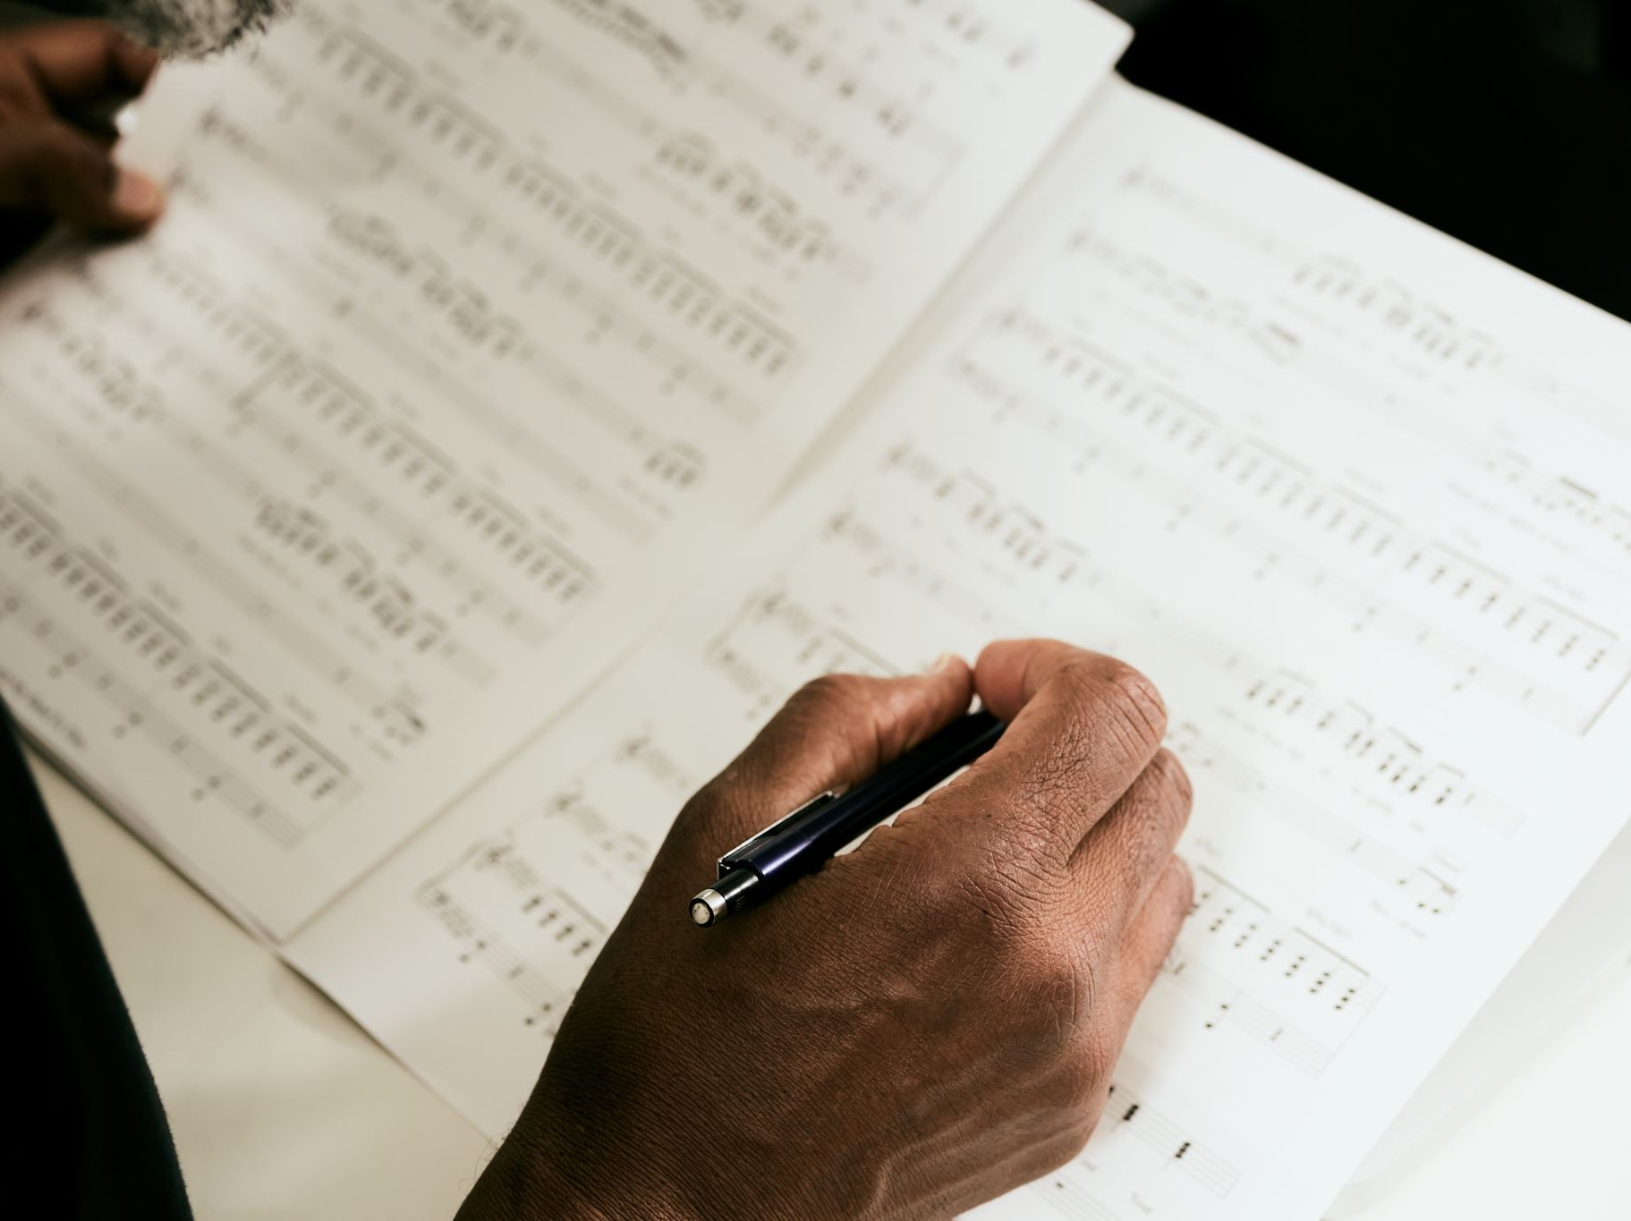
Section 3: The Poet as a Teacher
Sidney emphasizes the didactic role of the poet as a teacher and praises the ethical influence of poetry. He believes that poets can instill virtues and vices in their readers through the depiction of characters and events. The ethical function of poetry lies in its ability to shape moral character and elevate the human spirit.

Slide 8
Section 4: Pleasure and Entertainment
Sidney acknowledges that poetry provides pleasure and entertainment, which he considers a legitimate and essential aspect of literature. He defends the idea that delighting the reader does not diminish the intellectual or moral worth of a work. Sidney argues that poetry can be both enjoyable and instructive, combining pleasure with learning.

Slide 9
Section 5: Attacks on Poetry:
Throughout the essay, Sidney addresses the criticisms that poetry faced during his time. He criticizes those who dismissed poetry as trivial, arguing that such a view stems from a lack of understanding or an inability to appreciate its depth and significance. Sidney defends poetry against those who valued only practical and utilitarian forms of literature.

Slide 10
Section 6: Poetic Inspiration:
Sidney discusses the inspiration behind poetry and the role of the poet's creativity and imagination. He defends the use of fiction and allegory in poetry as powerful devices for conveying profound truths and ideas. Poetry draws from the richness of the human imagination, transcending the limitations of mere factual reporting.

Slide 11
Conclusion
Sidney concludes that poetry is an essential and elevated form of literature, capable of providing both pleasure and knowledge. He reaffirms the value of poetry as a means of instruction, inspiration, and ethical development. "An Apology for Poetry" stands as a defense of the poetic art and its enduring significance in human culture and education.
Thus, "An Apology for Poetry" showcases Sir Philip Sidney's deep understanding of classical and humanist traditions while advocating for the enduring importance of poetry as a form of expression, communication, and moral instruction.
In "An Apology for Poetry," Sidney defends poetry and poetic literature against the prevailing criticisms and attacks it faced during his time. The essay is written in the form of a dialogue, where Sidney, under the persona of an interlocutor named "Bussy D'Ambois," presents his arguments in favor of poetry.

Slide 12
Thank you!

